Slide 1

Flatten
Multi-hidden layers
Fully connected
Output
results
Input layer
0
1
2
…
8
9
…
High-speed On-chip MVM
ReLU
…
…
…
…
…
28×28×1
…
W
W^{T}
W
10×1
10×1
Features Abstract
Reuse operations

Slide 2
Flatten
Multi-hidden layers
Fully connected
Output
results
Input layer
0
1
2
…
8
9
…
High-speed On-chip MVM
ReLU
…
…
…
…
…
…
28×28×1
W
W^{T}
W
10×1
10×1
Features Abstract
Reuse operations

Slide 3
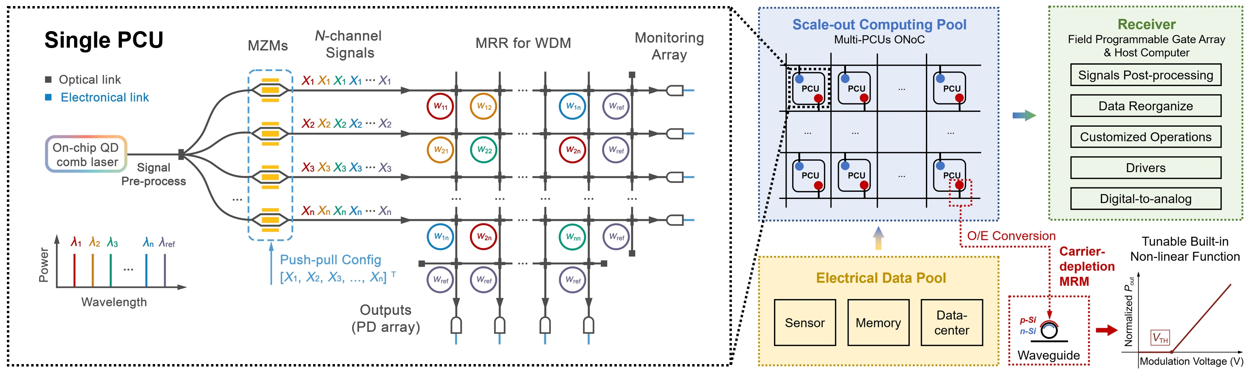
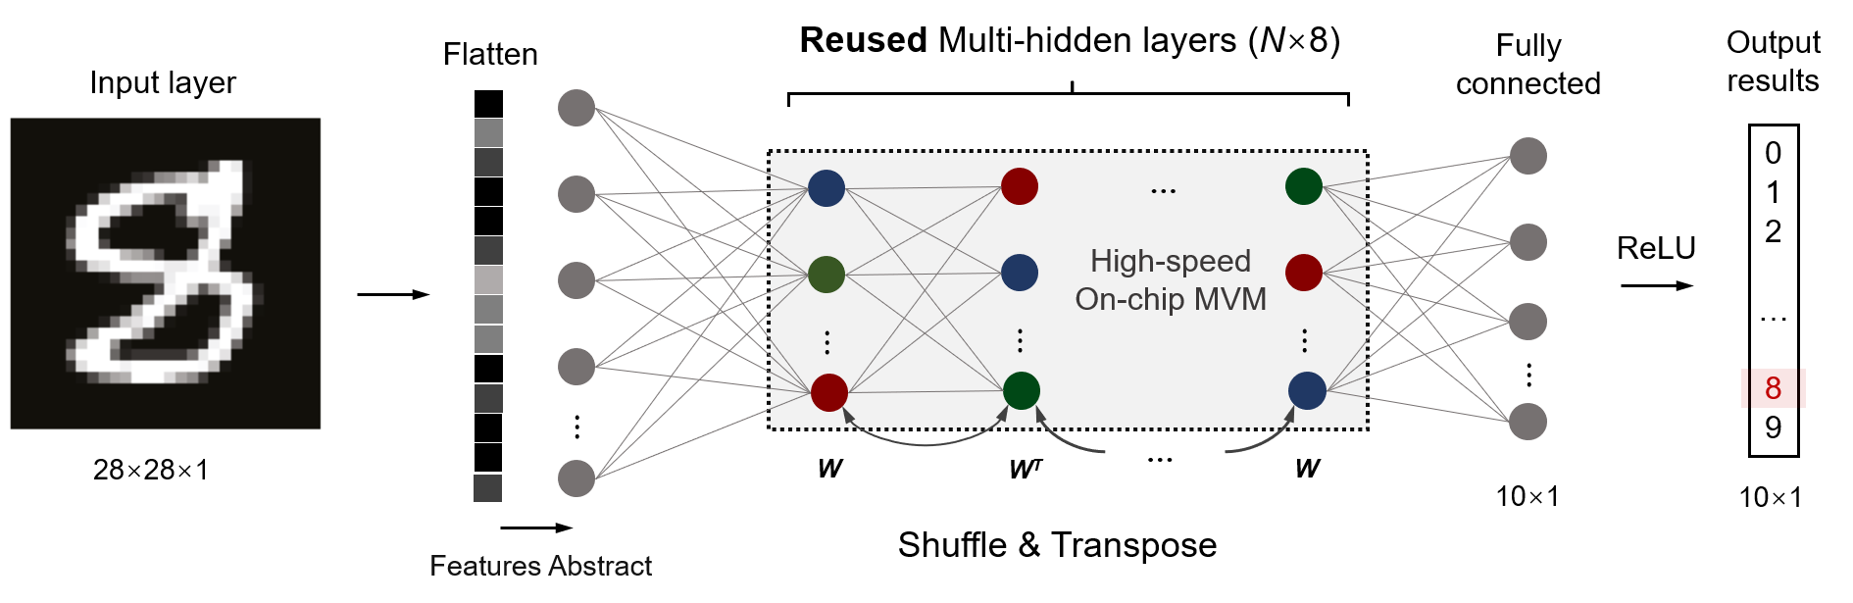
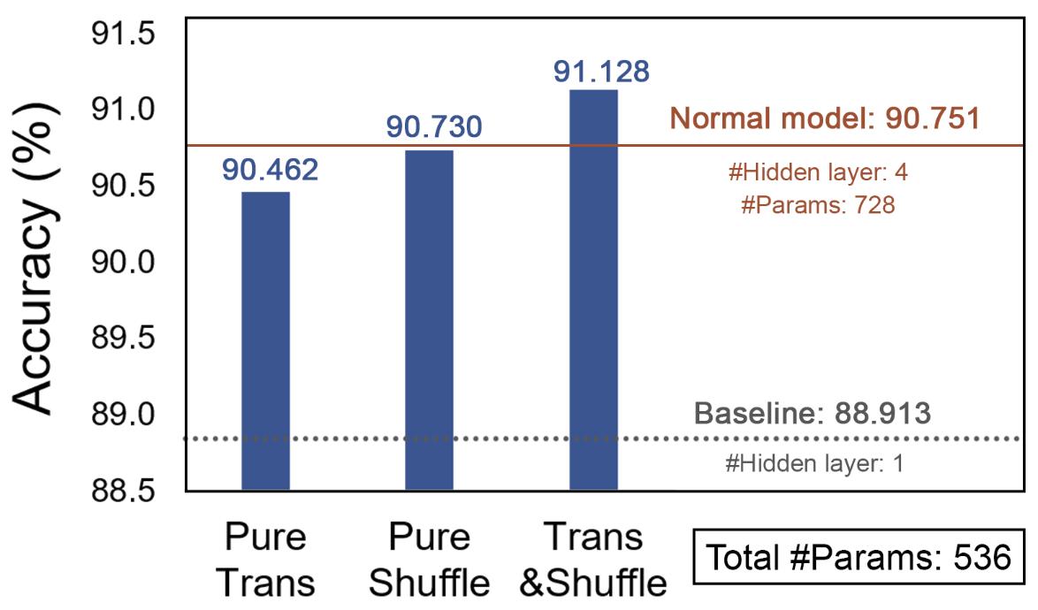

Slide 4
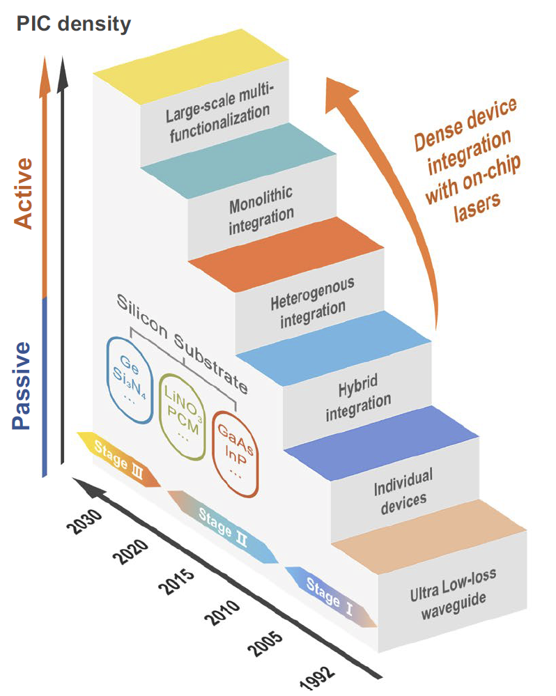
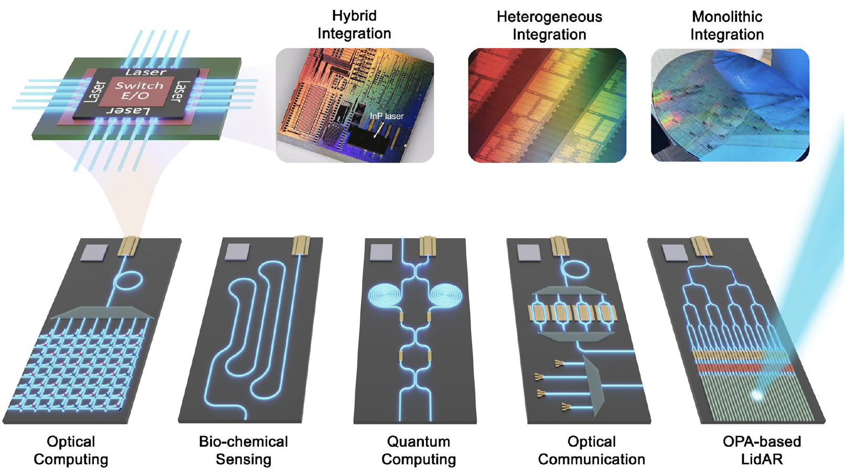

Slide 5
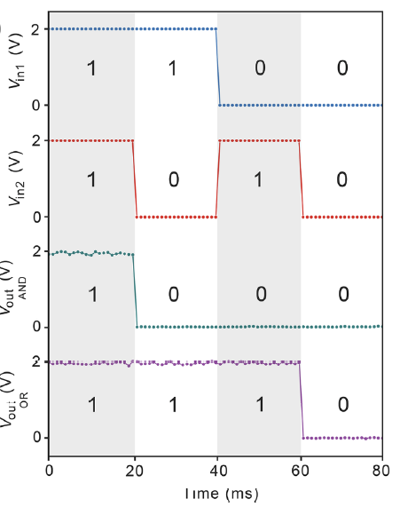
Single memristor device structure
Logic Function
Verification
Logic gate
Reconfigurable for dual-function
Test result
BNN Function
Verification

Slide 6
